Slide 1
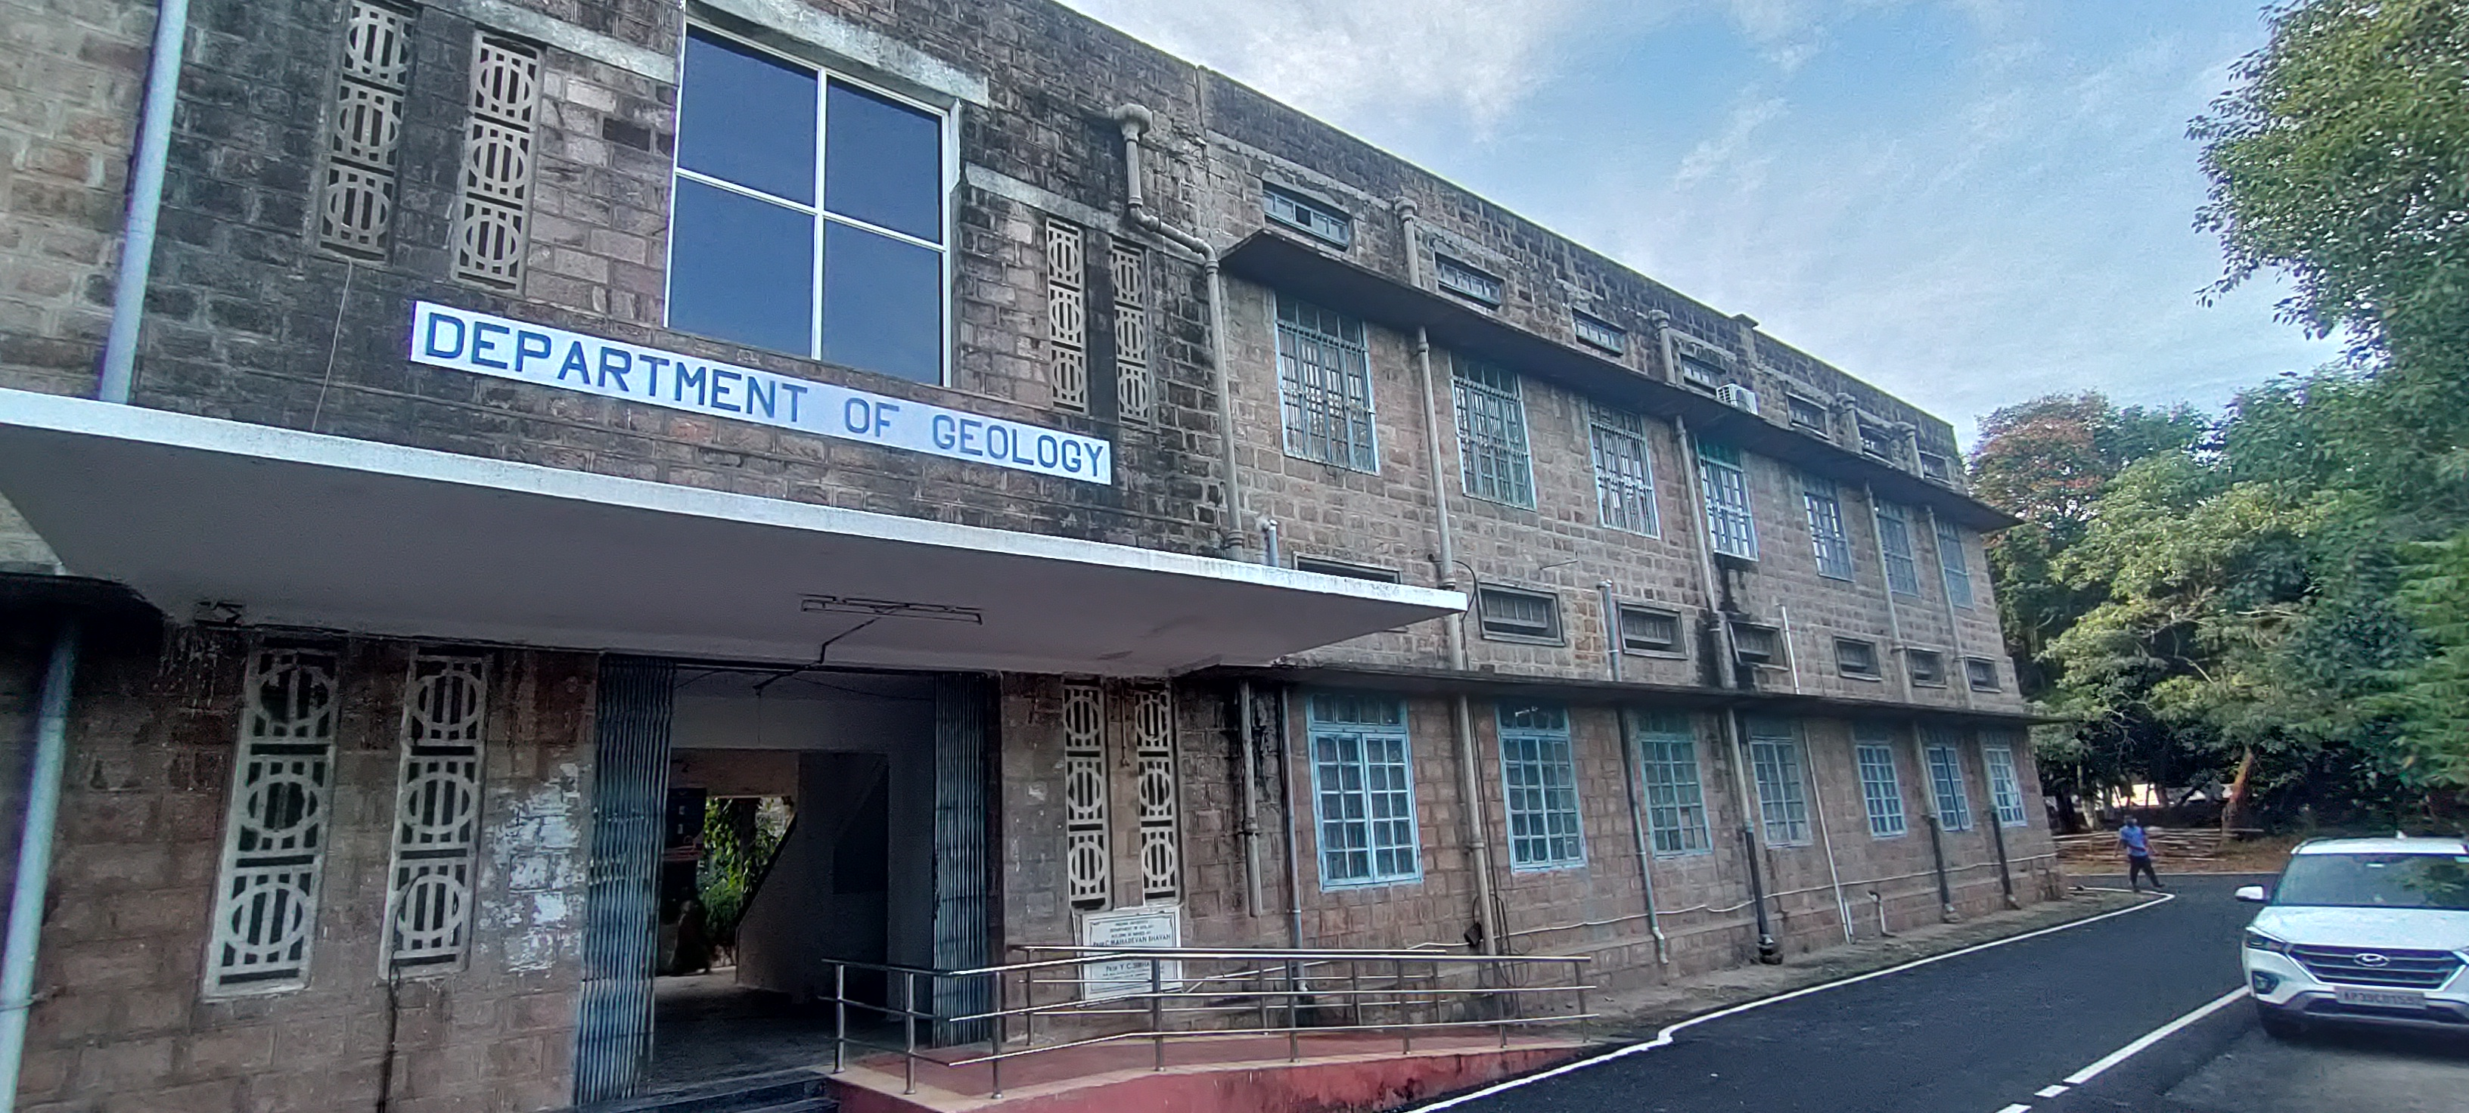
WELCOME TO
NAAC PEER TEAM
DEPARTMENT OF GEOLOGY
ANDHRA UNIVERSITY

Slide 2
VISION AND MISSION
VISION
To Impart advance training to manpower to cater the needs of the Nation (Geological Area)
MISSION
To Stimulate the academic for promotion of quality of teaching, learning and research.
To undertake quality related research studies, consultancy and training programmes.
To foster global competencies among students and to inculcate value system in them.
To promote the use of state-of-the-art technology and quest for excellence.

Slide 3
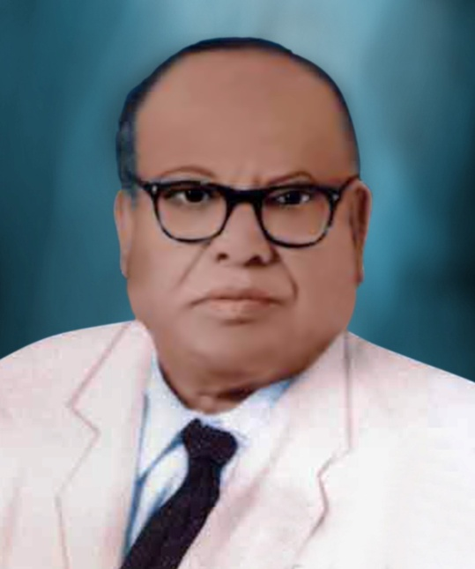
DEPARTMENT PROFILE
Started in 1941 with M.Sc Geology
M.Sc.(Tech) Applied Geology - 1952
Prof. C. Mahadevan
HISTORY / ACHIEVEMENTS
Prof. C. Mahadevan, initiated new branches like marine & nuclear geology.
Department supported under the UGC Special Assistance Programme from 1972 onwards in four phases as well as FIST.

Slide 4
HISTORY / ACHIEVEMENTS
Recognizing the contributions on Delta Studies and coastal geology from the department, a National Institute Delta Studies Institute was started (1997) in the campus with financial support from Oil Industry Development Board (OIDB) and Oil and Natural Gas Corporation Ltd. (ONGC).

Slide 5
CURRICULAR ASPECTS
Programmes offered
1. M.Sc. (Geology)
2. M.Sc.(Tech) Applied Geology
3. Doctoral Programmes Ph.D. (Geology)

Slide 6
1st Semester
M.Sc Geology
2nd Semester
S. No | Course
01 | Paper-I Mineralogy
02 | Paper-II Igneous and Metamorphic Petrology
03 | Paper-III Structural Geology & Tectonics
04 | Paper-IV Stratigraphy & Micropaleontology
05 | Field Work
S. No | Course
01 | Paper-I Sedimentology
02 | Paper-II Geochemistry & Isotope Geology
03 | Paper-III Hydrogeology
04 | Paper-IV Economic Geology & Indian Mineral Deposits
05 | Surveying
3rd Semester
4th Semester
S. No | Course
01 | Paper-I Mineral Exploration and Mineral Economics
02 | Paper-II Fuel Geology
03 | Paper-III Environmental Geology
04 | Paper-IV Sedimentary Basins of India
05 | Geological Mapping
S. No | Course
01 | Paper-I Marine Geology
02 | Paper-II Mining & Engineering Geology
03 | Paper-III Geomorphology Remote Sensing
04 | Paper-IV Project work

Slide 7
1st Semester
M.Sc (Tech) Applied Geology
2nd Semester
S. No | Course
01 | Paper – I Mineralogy
02 | Paper – II Igneous and Metamorphic Petrology
03 | Paper – III Structural Geology & Tectonics
04 | Paper – IV Sedimentology
05 | Field Work
S. No | Course
01 | Paper – I. Stratigraphy
02 | Paper – II Geochemistry & Isotope Geology
03 | Paper – III Sedimentary petrology
04 | Paper – IV Micropaleontology
05 | Surveying
3rd Semester
4th Semester
S. No | Course
01 | Paper – I Geomorphology, Remote Sensing & GIS
02 | Paper – II Geophysical Exploration
03 | Paper – III Hydrogeology
04 | Paper – IV Sedimentary Basin of India
05 | Geological Mapping
S. No | Course
01 | Paper – I Marine Geology
02 | Paper – II Geological & Geochemical Exploration
03 | Paper – III Engineering Geology
04 | Paper – IV Economic Geology & Indian Mineral Deposits
05 | Mining Training Programme

Slide 8
5th Semester
M.Sc (Tech) Applied Geology
6th Semester
S. No | Course
01 | Paper – I Surface and Underground Mining
02 | Paper – II Fuel Geology
03 | Paper – III Geo-Informatics
04 | Paper – IV Mine legislation & Mine Planning
S. No | Course
01 | Paper – I Mineral Economics
02 | Paper – II Environmental Geology
03 | Paper – III Mineral processing Engineering
04 | Paper – IV Project Oriented Dissertation
1. Value added Courses
Research Methodology
Intellectual Property Rights (IPR)
2. Massive Open Online Course (MOOCs)

Slide 9
Outcome Based Education (OBE) framework
Greater focus on course & programme outcomes.
Regular assessment and evaluation for continuous improvement of the programme.

Slide 10
DEPARTMENT OF GEOLOGY
ATTAINMENT REPORT FOR COURSE OUTCOMES (ARCO)
Course Name: |  |  |  | MINERALOGY
Course Code: |  |  |  | TH-SGS124 |  | Academic Year: |  | 2021-2022
Year & Semester: |  |  |  | I-I |  | Regulation: |  | 2019-2020
 | Sl No | Roll No | CO1 | CO2 | CO3 | CO4 | CO5 | OBE based result
 | 1 | 721210814001 | 42.00 | 42.00 | 42.00 | 42.00 | 42.00 | Cleared
 | 2 | 721210814002 | 57.00 | 57.00 | 57.00 | 57.00 | 57.00 | Cleared
 | 3 | 721210814003 | 53.00 | 53.00 | 53.00 | 53.00 | 53.00 | Cleared
 | 4 | 721210814004 | 55.00 | 55.00 | 55.00 | 55.00 | 55.00 | Cleared
 | 5 | 721210814005 | 49.00 | 49.00 | 49.00 | 49.00 | 49.00 | Cleared
 | 6 | 721210814006 | 44.00 | 44.00 | 44.00 | 44.00 | 44.00 | Cleared
 | 7 | 721210814007 | 45.00 | 45.00 | 45.00 | 45.00 | 45.00 | Cleared
 | 8 | 721210814008 | 32.00 | 32.00 | 32.00 | 32.00 | 32.00 | Not Attained
 | 9 | 721210814009 | 57.00 | 57.00 | 57.00 | 57.00 | 57.00 | Cleared
 | 10 | 721210814010 | 58.00 | 58.00 | 58.00 | 58.00 | 58.00 | Cleared
 | 11 | 721210814011 | 43.00 | 43.00 | 43.00 | 43.00 | 43.00 | Cleared
 | 12 | 721210814012 | 49.00 | 49.00 | 49.00 | 49.00 | 49.00 | Cleared
 | 13 | 721210814013 | 41.00 | 41.00 | 41.00 | 41.00 | 41.00 | Cleared
 | 14 | 721210814014 | 32.00 | 32.00 | 32.00 | 32.00 | 32.00 | Not Attained
 | 15 | 721210814015 | 41.00 | 41.00 | 41.00 | 41.00 | 41.00 | Cleared
 | 16 | 721210814016 | 44.00 | 44.00 | 44.00 | 44.00 | 44.00 | Cleared
 | 17 | 721210814017 | 66.00 | 66.00 | 66.00 | 66.00 | 66.00 | Cleared
 | 18 | 721210814018 | 47.00 | 47.00 | 47.00 | 47.00 | 47.00 | Cleared
 | 19 | 721210814019 | 52.00 | 52.00 | 52.00 | 52.00 | 52.00 | Cleared
 | 20 | 721210814020 | 40.00 | 40.00 | 40.00 | 40.00 | 40.00 | Cleared
 | 21 | 721210814021 | 45.00 | 45.00 | 45.00 | 45.00 | 45.00 | Cleared
 | 22 | 721210814022 | 53.00 | 53.00 | 53.00 | 53.00 | 53.00 | Cleared
 | 23 | 721210814023 | 44.00 | 44.00 | 44.00 | 44.00 | 44.00 | Cleared
 | 24 | 721210814024 | 43.00 | 43.00 | 43.00 | 43.00 | 43.00 | Cleared
 | 25 | 721210814025 | 46.00 | 46.00 | 46.00 | 46.00 | 46.00 | Cleared
 | 26 | 721210814026 | 59.00 | 59.00 | 59.00 | 59.00 | 59.00 | Cleared
Final CO Calculation
Course Outcomes | Overall CO Attainment | Level Attained 1/2/3
CO1 | 92.31 | 3
CO2 | 92.31 | 3
CO3 | 92.31 | 3
CO4 | 92.31 | 3
CO5 | 92.31 | 3
 | Final CO attainment of Course Name | 3
If 85% or more of the students attain the set target, the attainment level is 3.
If 75% or more of the students attain the set target, the attainment level is 2
Otherwise the students attain the attainment level is 1

Slide 11
POs
M.Sc Geology
Programme Outcomes: (PO)
PO₁ To impart Geological knowledge with emphasis on courses relevant to the societal benefits.
PO₂ To enhance the information of geological science by introducing Remote Sensing and GIS
PO₃ To prepare the students to learn the subject outside the class room i.e. through geological field work and mapping
PO₄ To learn the subject by applying the theoretical knowledge in laboratory
PO₅ To apply the principles of geology to carry out project dissertation
PO₆ To apply the classroom knowledge to mitigate the geological hazards and other environmental problems.
PO₇ To obtain and apply the geological information for exploring the fuels, minerals and Ground water
PO₈ To prepare the students to face and resolve the real world problems by applying the learnt geological knowledge

Slide 12
M.Sc (Tech) Applied Geology
Programme Outcomes: (PO)
PO₁ To Impart geological information on various geological processes and palaeontology.
PO₂ To enhance knowledge of geological science with special emphasis on various applied aspects of Geology.
PO₃ To acquire data about mineral formation processes, distribution, occurrences and water resources.
PO₄ To get knowledge on minerals, fuels and Groundwater exploration methods and interpretation techniques
PO₅ To understand various Metallic and non- Metallic mining Methods.
PO₆ To impart skills on ore dressing and Mineral Beneficiation Techniques for various minerals
PO₇ To enhance knowledge about various geoenvironments, impacts of mining, civil structures, Environmental Impact Assessment, pollution and Geohazards
PO₈ To train students to carryout geological mapping, remote sensing and GIS on various geological terrains.

Slide 13
PO’s achievement methods
Observation of Geological features in the field
Development of observation skills
Improvement of social interaction among the students
Development of creativity skill among students

Slide 14
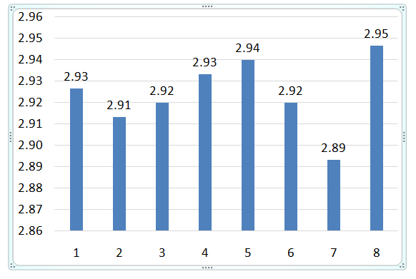
PO Attainment Level (Average PO Attainment of M.Sc Geology Program)
PO₁ Societal benefits.
PO₂ Remote sensing & GIS
PO₃ Geological field work & mapping
PO₄ Knowledge in laboratory
PO₅ Project dissertation
PO₆ Geological hazards & environmental problems.
PO₇ Fuels, minerals & Ground water
PO₈ Real world problems
> 85% attain the set targets (Level 3)

Slide 15
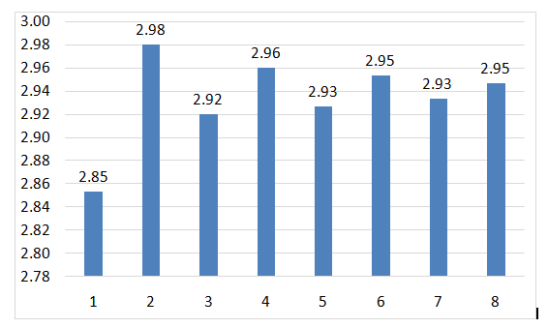
PO Attainment Level (Average PO Attainment of M.Sc (Tech) Applied Geology Program)
PO₁ Geological processes & palaeontology.
PO₂ Applied aspects of Geology.
PO₃ Mineral formation processes
PO₄ Fuels and Groundwater exploration methods
PO₅ Mining Methods.
PO₆ Mineral Beneficiation
PO₇ Geo-hazards
PO₈ Geological mapping, RS & GIS
> 85% attain the set targets (Level 3)

Slide 16
Integration of Environmental Sustainability, Human values in the Curriculum
Teaching: Environmental Geology
Environmental Impact Assessment
Environmental Management
Sustainable Mining
Coastal & Marine Environment Laws
Courses with employability/Skill development/value added programmes offered
Geological Surveying
Geological Field Training
Geological Mapping camps
Mining training Programme
Enhance Geological Skills of the students

Slide 17
Student Project works
Project work is made compulsory and has been practiced very qualitatively with various industries

Slide 18
Skill development programmes
1. GIS
2. Surveying
3. Students attended online training courses conducted by GSI

Slide 19
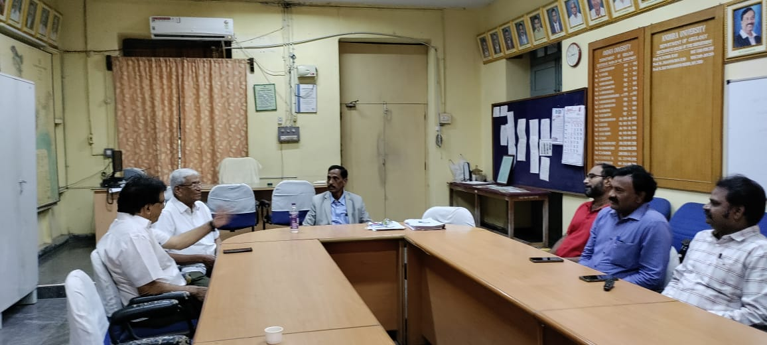
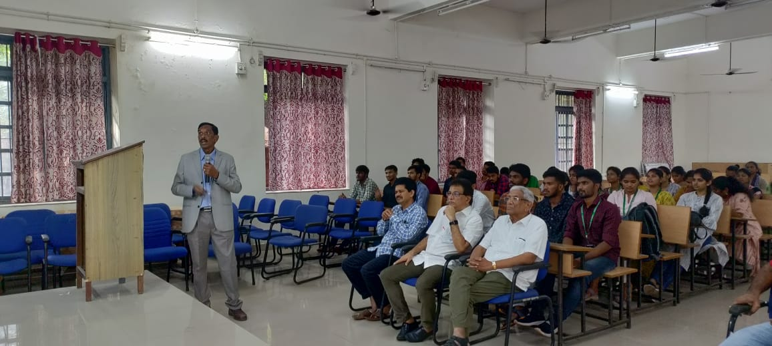
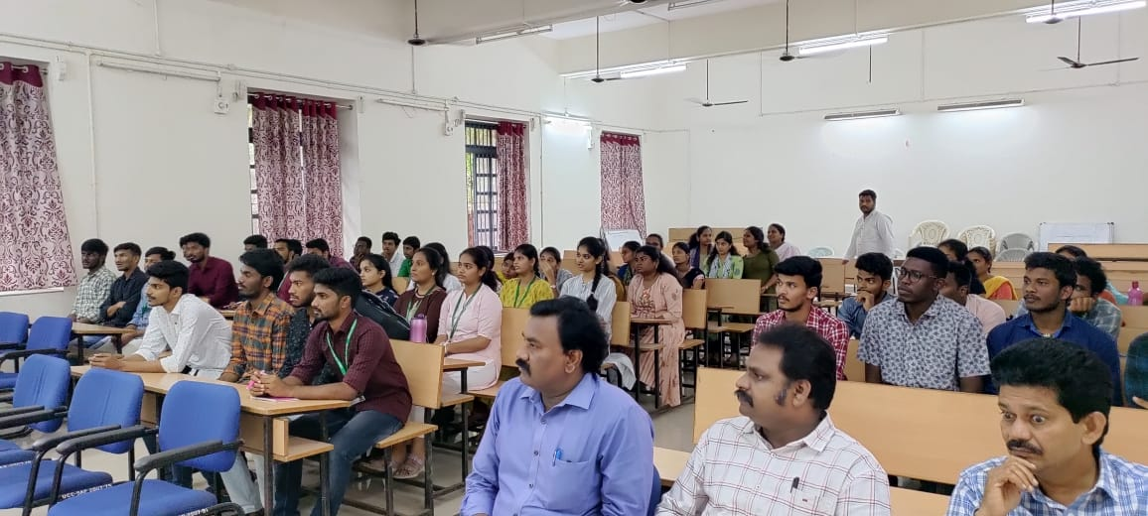
A special talk was delivered by the Dr. Kutuba Rao, Former Director General, GSI

Slide 20
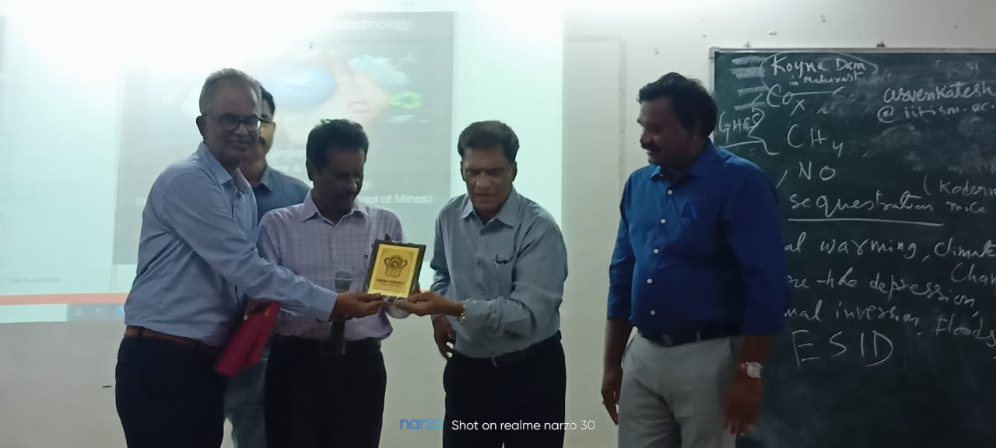
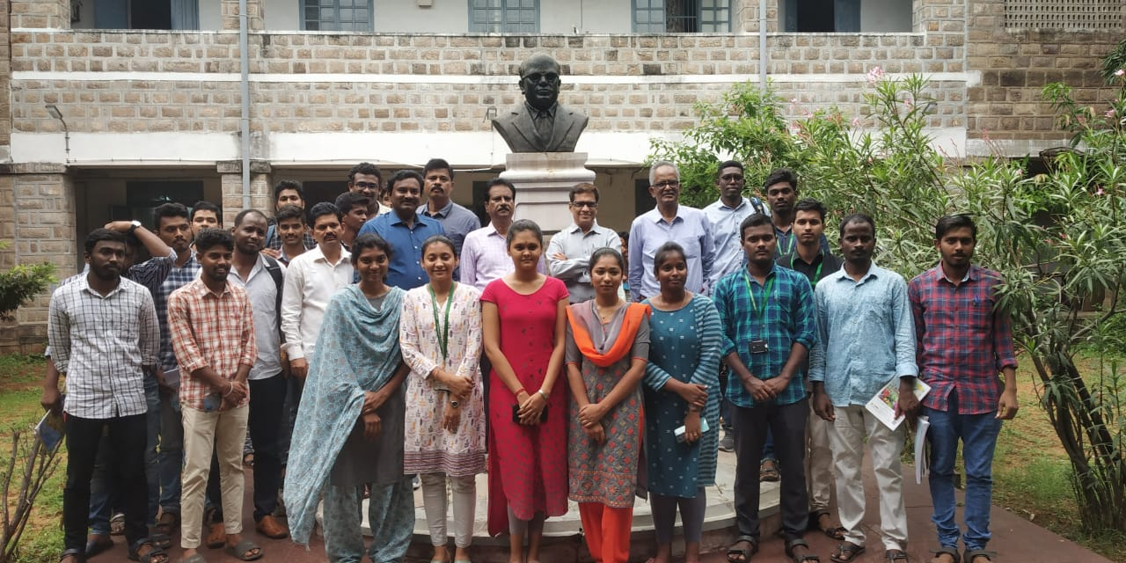
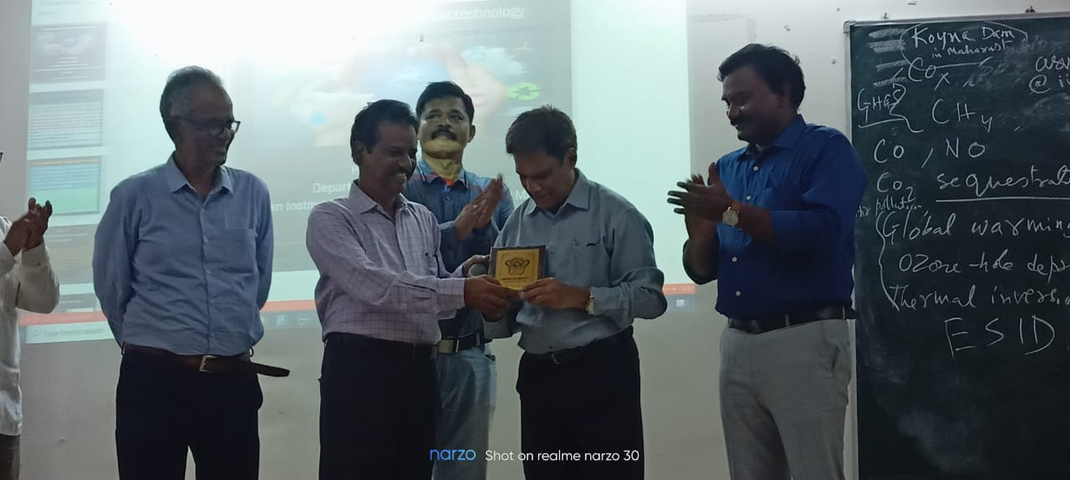
Lecture on Environmental Geology delivered by Prof. A.S. Venkatesh, Head, IIT (ISM), Dhanbad.

Slide 21
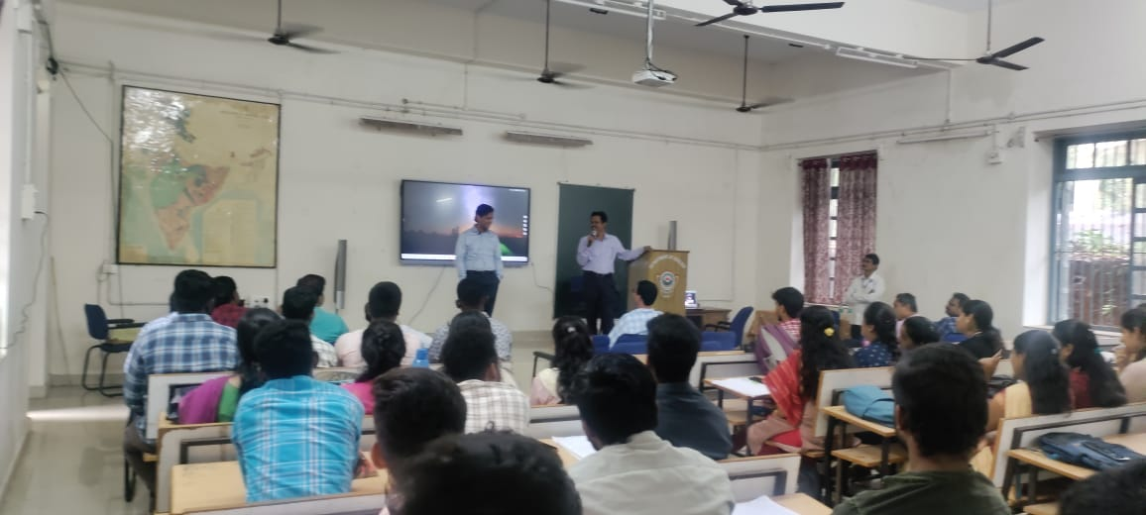
Lecture on “Petrology of Alkaline Rocks of India” was delivered by the Debajyoti Paul, Department of Earth Sciences, IIT Kanpur on 12-12-2022

Slide 22
Lecture on Bauxite Deposits of India by Dr. PK Ramam

Slide 23
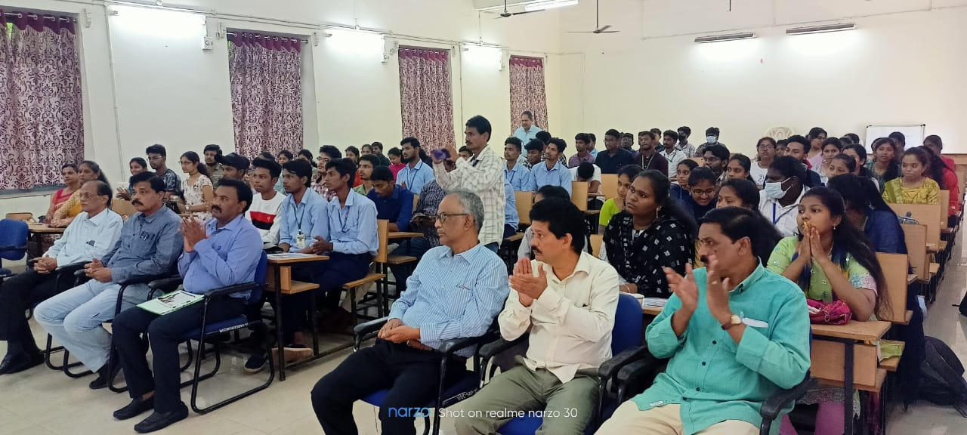
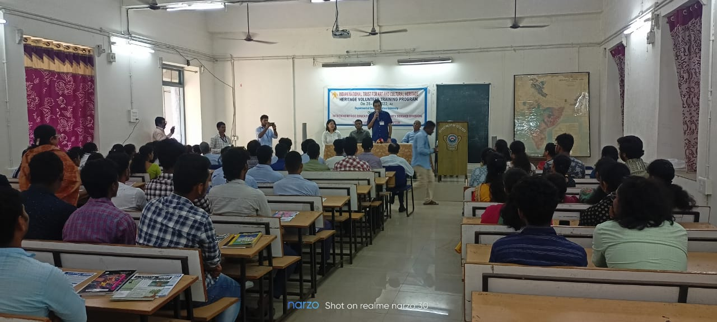
Training programme organised with collaboration INTACH, Visakhapatnam

Slide 24
Workshop on Introduction to Seismic Interpretation Dr.DM Nathaniel, Director, Nate Petroleum Development & Research LLP, Navi Mumbai on 17-10-2022.

Slide 25
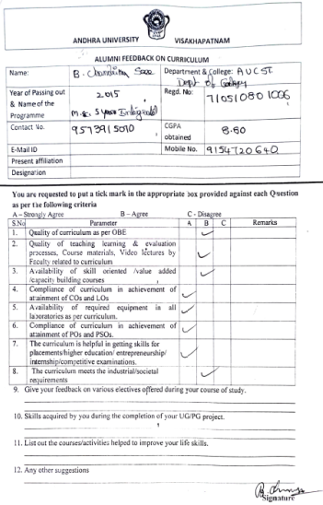
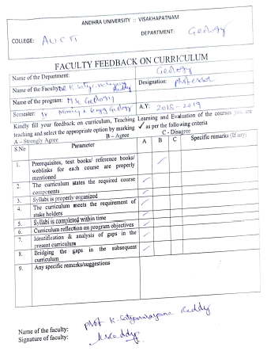
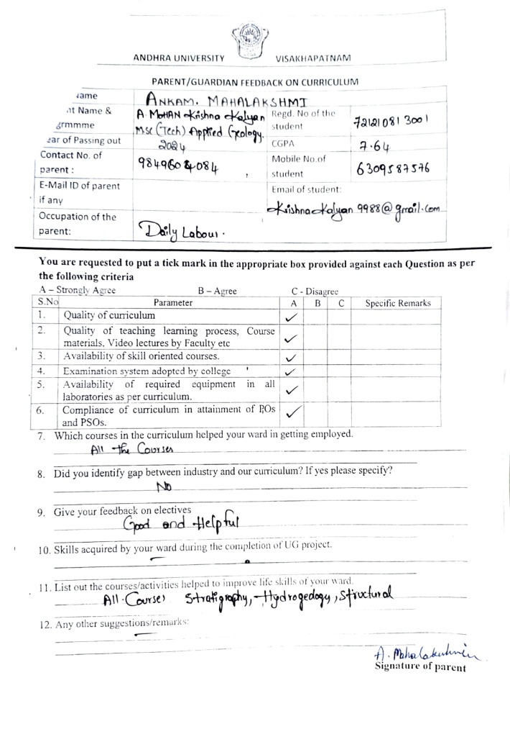
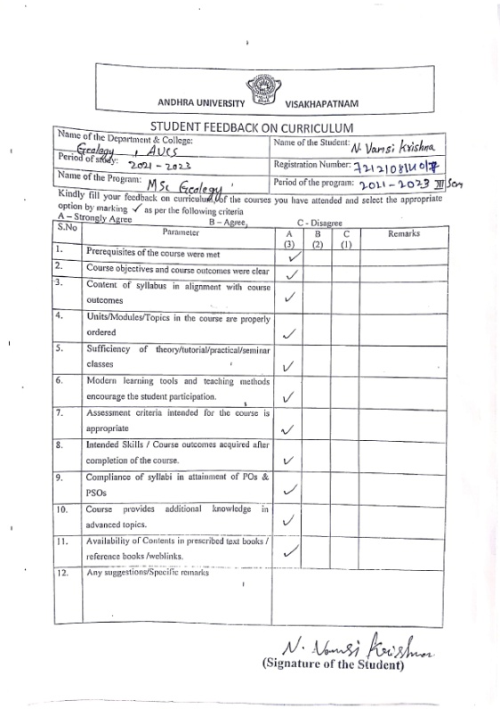
Feedback for curriculum collected and analysed report
Student, Faculty, Alumni, Parents, Employee, ONLINE

Slide 26
Teacher’s – Profile
Name | Designation | Vidwan Link | Specialization
Prof. K.S.N.Reddy | Professor & Head of the Department | https://vidwan.inflibnet.ac.in/profile/223409 | Marine Geology and Placers
Prof. E.N.DhananjayaRao | Professor & Chairman PG Board of Studies | https://vidwan.inflibnet.ac.in/profile/223421 | Geomorphology, Remote Sensing/GIS applications
Dr. A. Santharam | Professor | https://vidwan.inflibnet.ac.in/profile/245052 | Mining, Mineral Economics
Dr.G.Narayana Rao | Professor | https://andhrauniversity.irins.org/profile/245042 | Petroleum Geology, Sedimentology, Fuel Geology
Dr.A. Yugandhra Rao | Professor | https://vidwan.inflibnet.ac.in/profile/245097 | Marine Geology, Environmental Geology & Mineral Exploration
Dr.A.V.S.S Anand | Professor | https://vidwan.inflibnet.ac.in/profile/244297 | Hydrogeology, Remote Sensing & GIS
Dr. N. Kutumba rao | Professor (Professor of practice) | https://vidwan.inflibnet.ac.in/profile/443869 | Stratigraphy
Dr. B. L. Narasayya | Professor (Professor of practice) | https://vidwan.inflibnet.ac.in/profile/443865 | Mineralogy
Dr. J. Venkata Ramana | Assistant Professor(C) | https://vidwan.inflibnet.ac.in/profile/244882 | Mineral Exploration , Economic Geology, Mineralogy & Surveying
Dr. M. Srinivasa Rao | Assistant Professor(C) | https://vidwan.inflibnet.ac.in/profile/244886 | Geo Chemistry and isotope Geology , Structural Geology and tectonics, Economic Geology and Sedimentary Basins of India
Dr. G. Raja Rao | Assistant Professor(C) | https://vidwan.inflibnet.ac.in/profile/244883 | Fuel Geology, Marine Geology, Stratigraphy & Micropaleontology
Dr. K. Arjunudu | Assistant Professor(C) | https://andhrauniversity.irins.org/profile/245132 | Igneous and Metamorphic Petrology , Environmental Geology, Sedimentary Petrology
Dr. T. Karuna karudu | Assistant Professor(C) | https://andhrauniversity.irins.org/profile/244875 | Sedimentology & Mineralogy

Slide 27
Teachers-Research Profile
Publications & PhDs
S.No | Name | Total | Last five years
1 | Publications | 1575 | 67
2. | Ph.Ds | 284 | 31

Slide 28
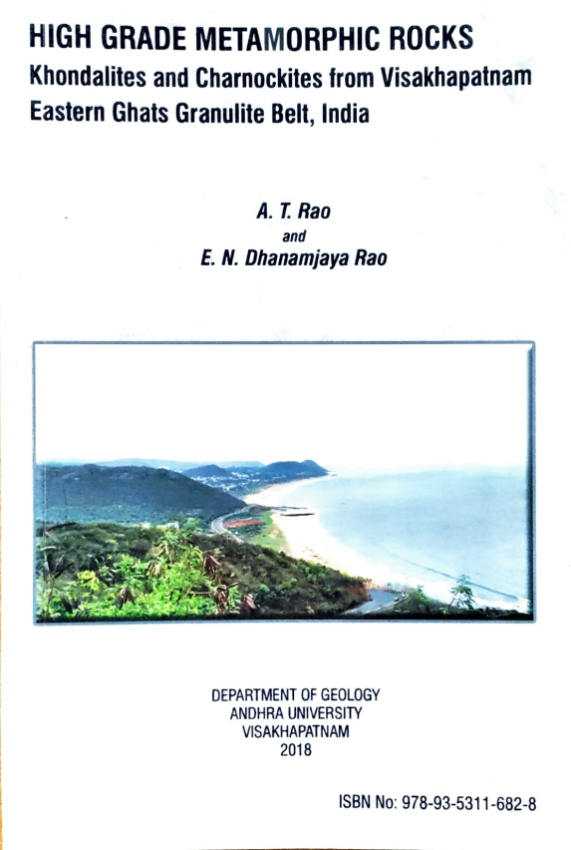
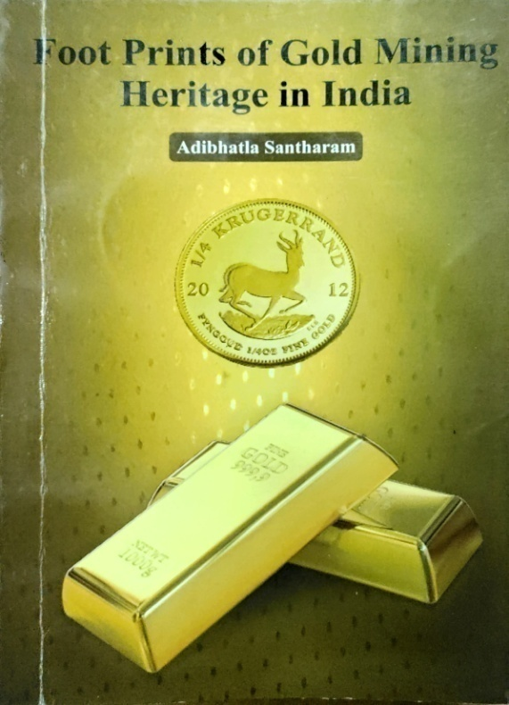
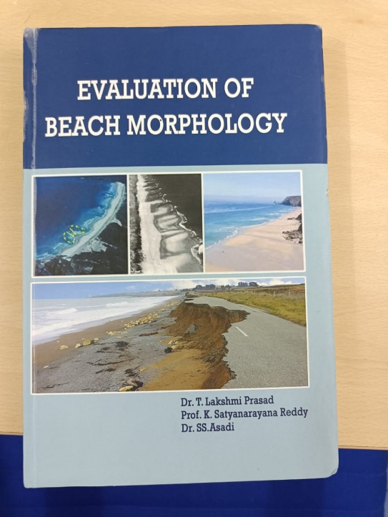
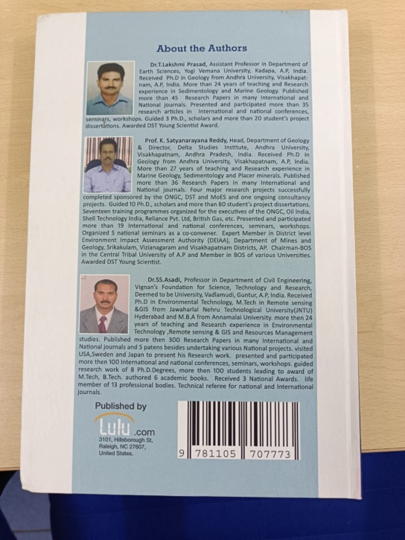
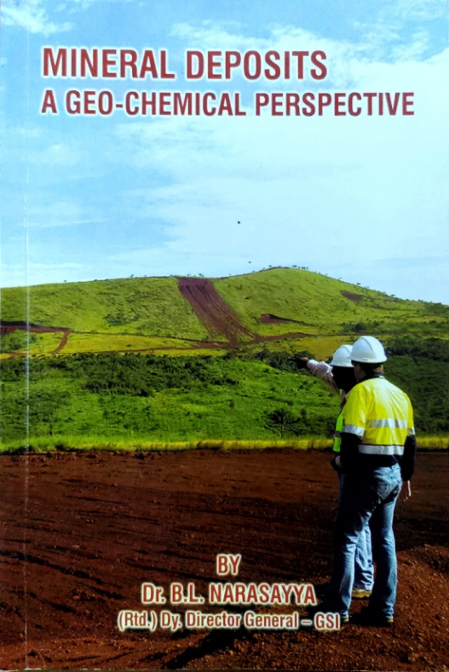
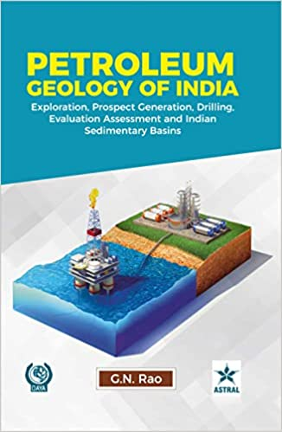
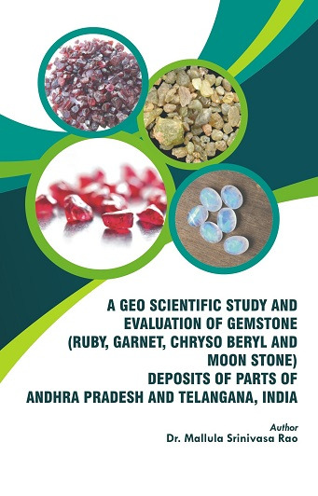
Books Published by the Faculty

Slide 29
Books Published by the Faculty
Prof. A.T. Rao and Prof. E.N. Dhanamjaya Rao – High Grade Metamorphic Rocks (Khondalites and Charnockites from Visakhapatnam Eastern Ghats Granulite Belt, India – 2018
Dr. T. Lakshmiprasad, Prof. KSN Reddy, and Dr. SS Asadi - Evaluation of Beach Morphology – 2021
Dr. Adibhatla Santharam – Foot Prints of Gold Mining Heritage in India - 2021
Dr. G.N. Rao – Petroleum Geology of India (Exploration, Prospect Generation, Drilling, Evaluation Assessment and Indian Sedimentary Basins) – 2022
Dr. Mallula Srinivasa Rao – A Geo Scientific study and Evaluation of Gemstone (Ruby, Garnet, Chryso beryl and Moon Stone) Deposits of parts of Andhra Pradesh and Telangana, India – 2022
Prof. M. Jagannadha Rao - Cracking MCQS in Geology An Analytical Digest -2018

Slide 30
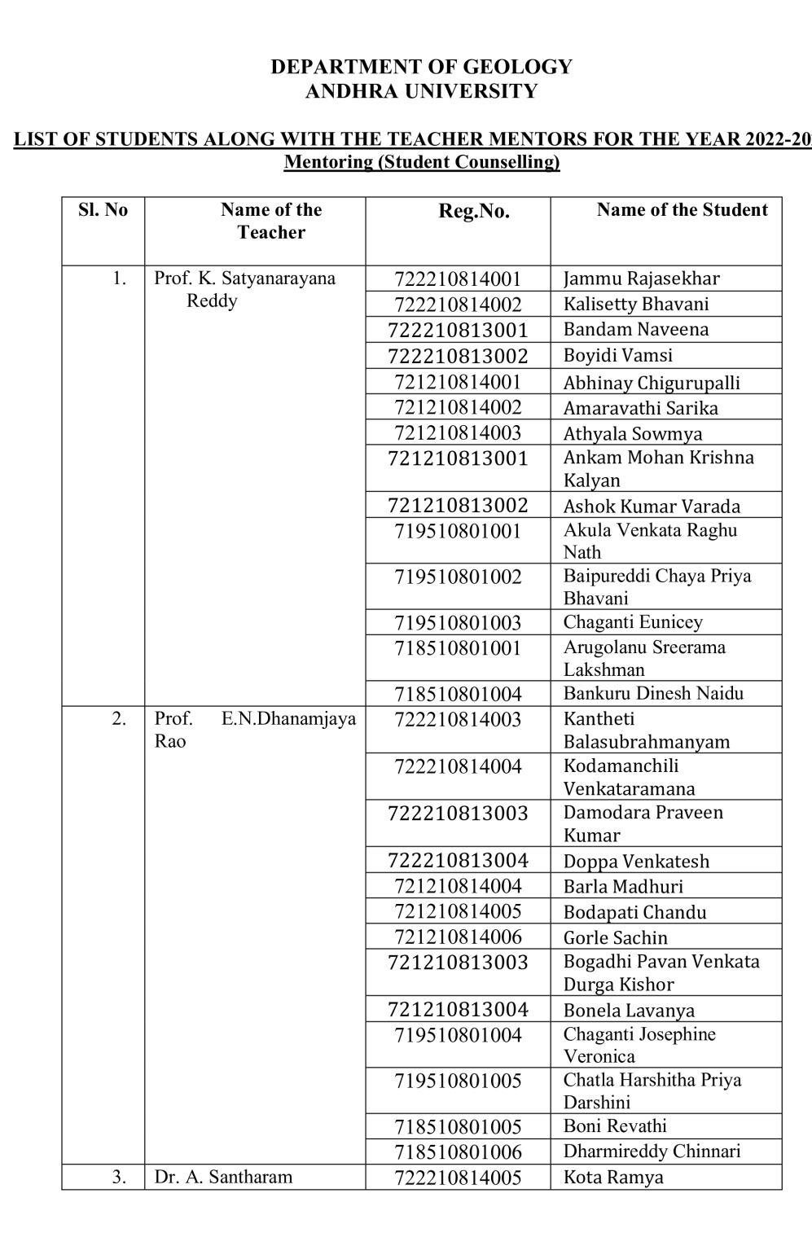
Mentor/Mentee System
All the teachers were assigned mentorship for students project works.

Slide 31
Workshop/Seminar/Conferences/Training programmes attended
2017-18 (05)
2018-19 (02)
2019-20 (12)
2020-21 (17)
2021-22 (05)

Slide 33
Students Diversity M.Sc Geology

Slide 34
M.Sc (Tech) Applied Geology

Slide 35
Number of Students

Slide 36
Number of Students

Slide 37
Awards
Students Support and Proregression:
Scholarship received
Prof. C. Mahadevan student ship awards – List of meritorious students of Geology Department, Andhra University
ONGC
Prof. A Srirama Das Shastipurthi Gold Medal
M.Sc.(Tech) Applied Geology Prize
M.Sc.(Tech) Applied Geology Martyn and John Zeiglar Prize

Slide 38
Students Progression
Higher Education
1. Ph.D
2. IIT
3. M.S

Slide 39
Placements
75%

Slide 40
Programmes for Advanced Learners
Encouraging to present papers in Journals/ Conferences/ Competitions
Guidance for UPSC Geologist, GATE/ CSIR NET competitive Examinations
Individual guidance for career building apart from placements in the campus

Slide 41
Programmes for Average Learners
Guidance for UPSC Geologist, GATE/ CSIR NET competitive Examinations
Personality development programmes
Programmes on communication skills Participation in Conferences, workshops, Seminars, Symposiums, and presenting articles and display models
Pre-placement training

Slide 42
Improved Performance for slow learners
Assignments/ previous question papers
Fortnightly Remedial classes
Individual Counseling

Slide 43
Fellowship Details
Number of Research Scholars – 26
Eleven candidates pursuing Ph.D. program under JRF/SRF
Ten students got selected NET/SET and GATE

Slide 44
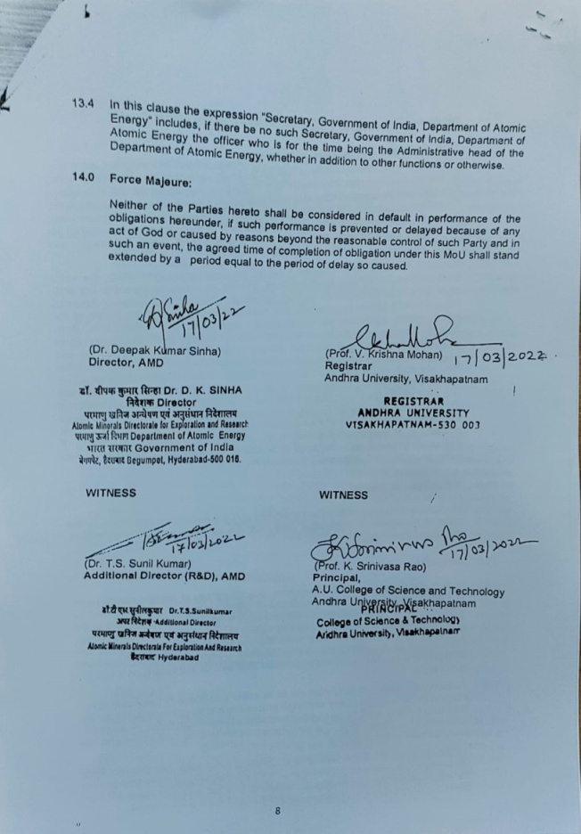
MoU with AMD
MoUs
Atomic minerals Directorate for Exploration and Research, Department of Atomic Energy,
Geological Survey of India

Slide 45
Consultancy Projects (Centre for Industrial & Scientific Consultancy)
1. M/s Charles Tenant & Company (Canada) Limited
- Rs. 49,560/-
2. MCS Resources Private Limited – Rs. 1,68,740/-
3. Ecomen Laboratories Pvt. Ltd - Rs. 3,83,500/-
4. M/s. RBSSD & FN DAS - Rs. 10,00300/-
(Slope Stability Investigations-(3), Manganese Mines)

Slide 46
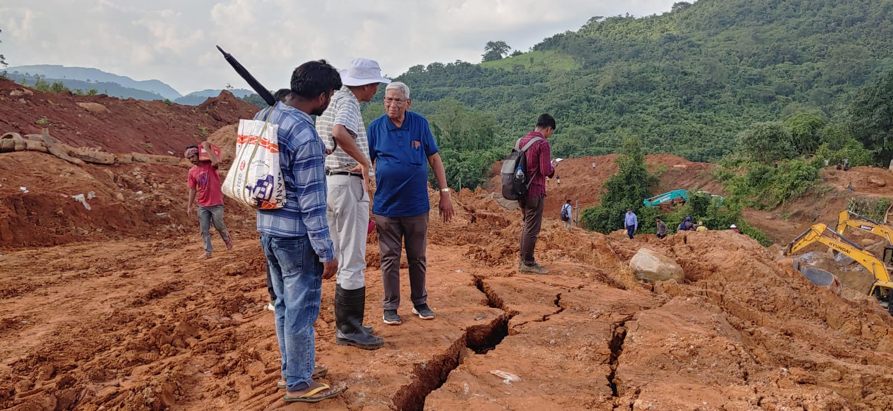
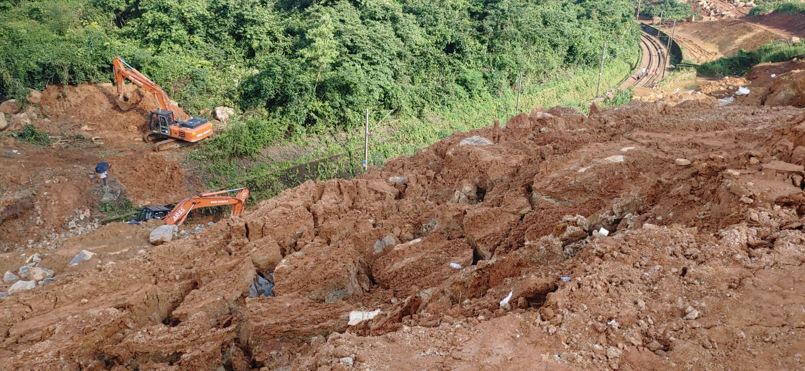
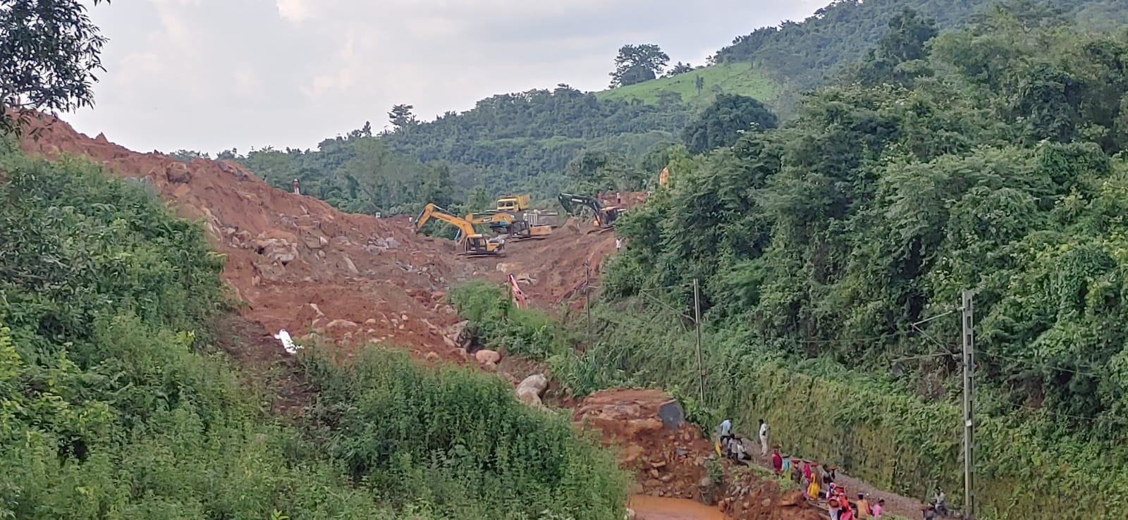
Up-coming projects (East Coast Railway)
Landslide Slope Stability Investigations
Koraput –Kirandul line at near Koraput
Boddavara – Karaka valasa

Slide 47
Cultural activities/Yoga participation/ Participation in games
Cultural activities:
Conducting student Fresher’s / Farewell programmes Yearly
Swachh Bharat Programme are being conducted every Saturday
Geological Exhibitions are conducted to promote awareness
Participation in games:
Cricket, Kho Kho and Volley Ball

Slide 48
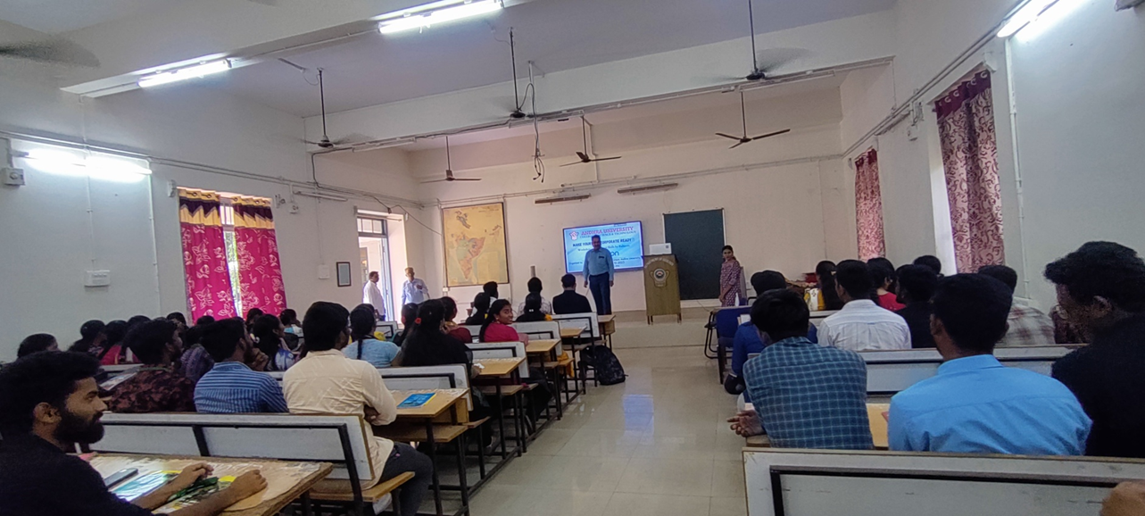
Career counselling/placement guidance provided to students from time to time.

Slide 49
Infrastructure and teaching resources:
Physical facilities
Library, Museum
Class rooms/ laboratories/Seminar halls
Class rooms – 08
Laboratories – 10
Seminar halls - 01
Computing equipment /Smart Boards
Computers - 15
Interactive smart boards - 02

Slide 50
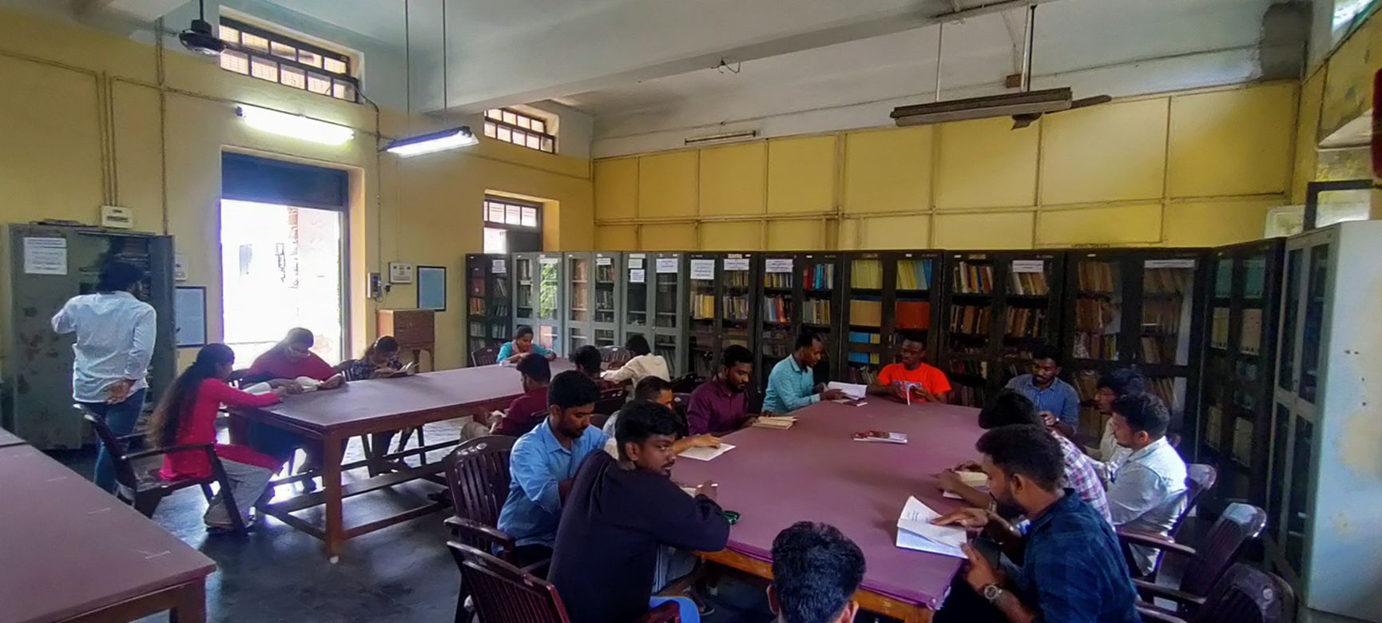
Department library /e -resources/Wi-fi/internet facilities/Bandwidth/link to library e resources
Using Wi-fi/internet, students can connect to the University General Pool e-Resources.

Slide 51
MUSEUM

Slide 52
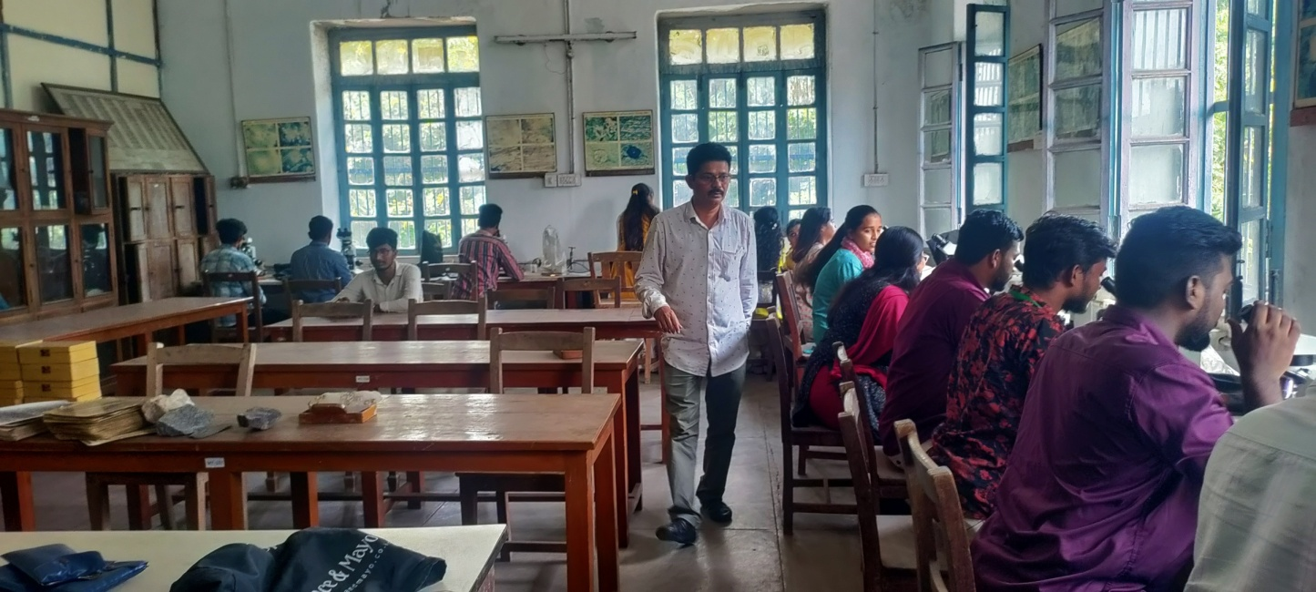
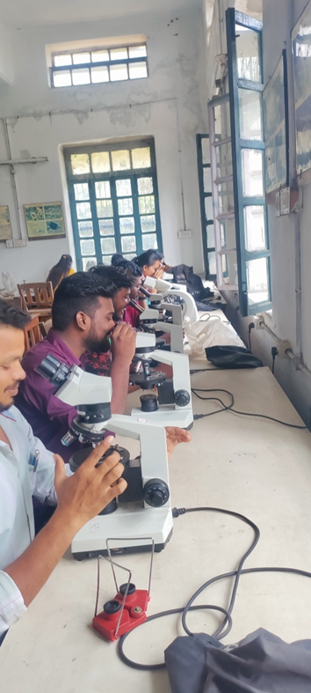
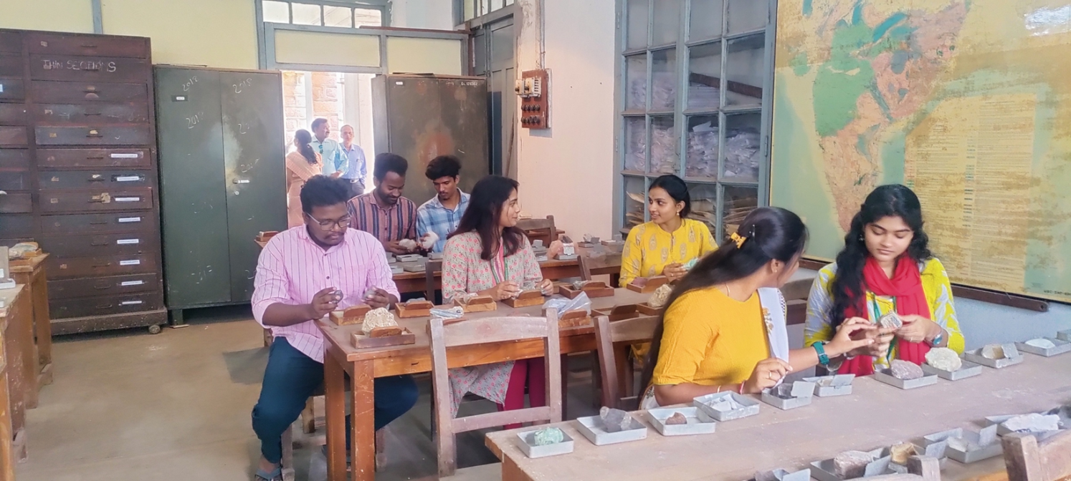
OPTICAL LAB

Slide 53
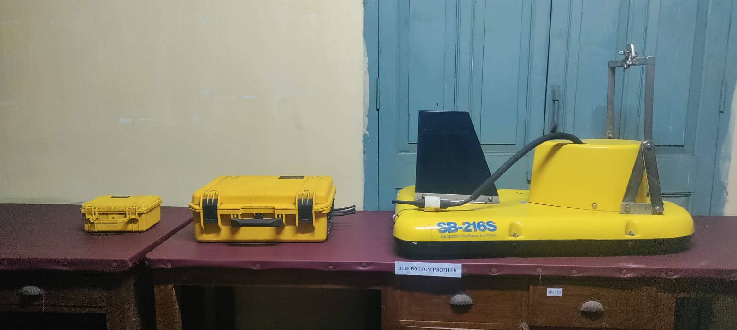
Sub-Bottom Profiler

Slide 54
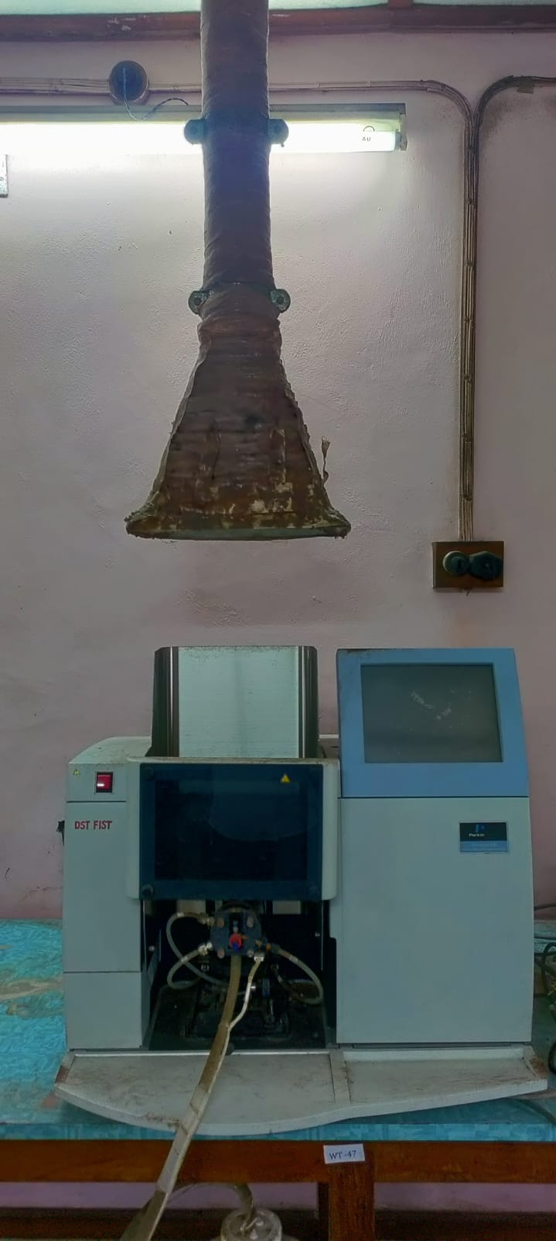
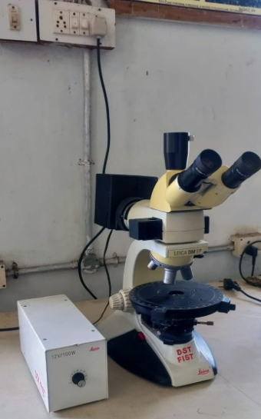
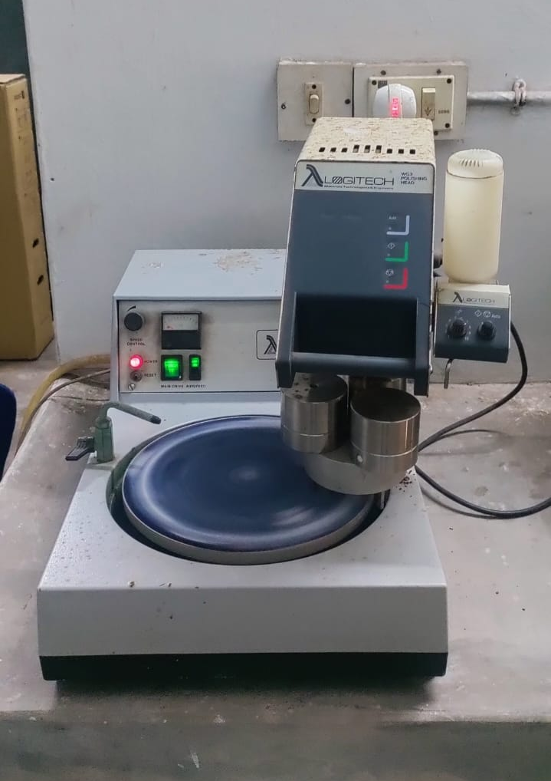
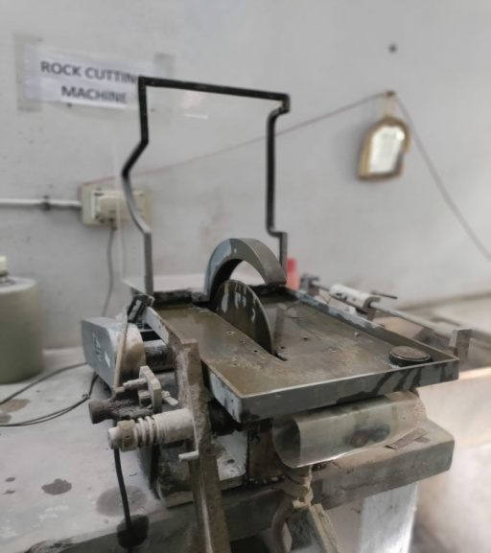
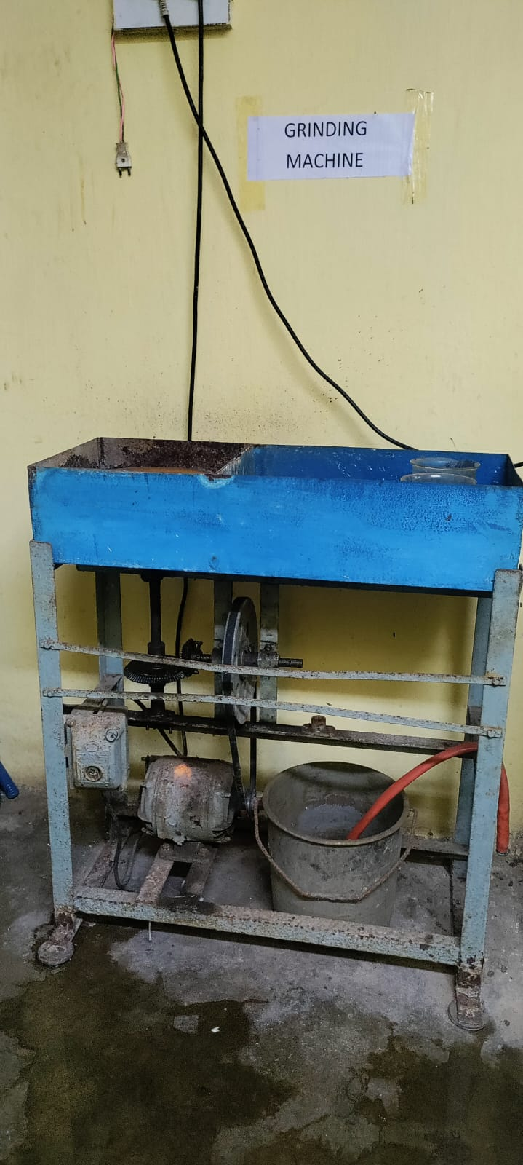
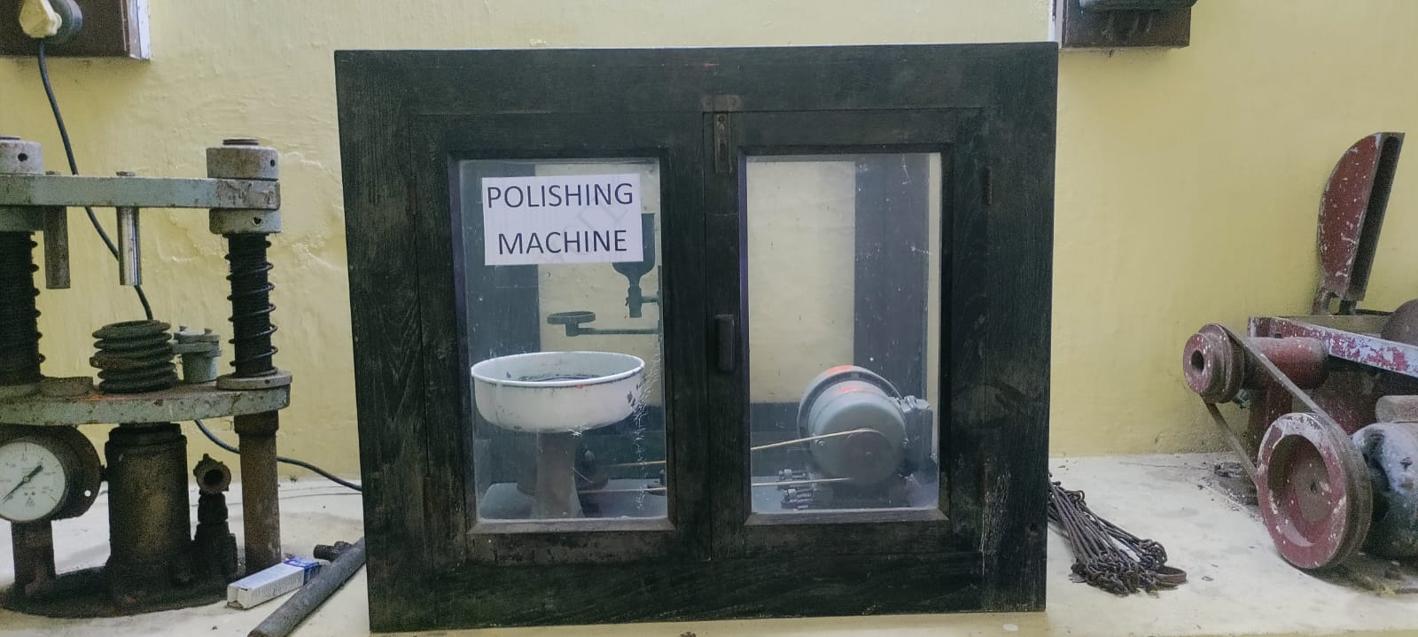
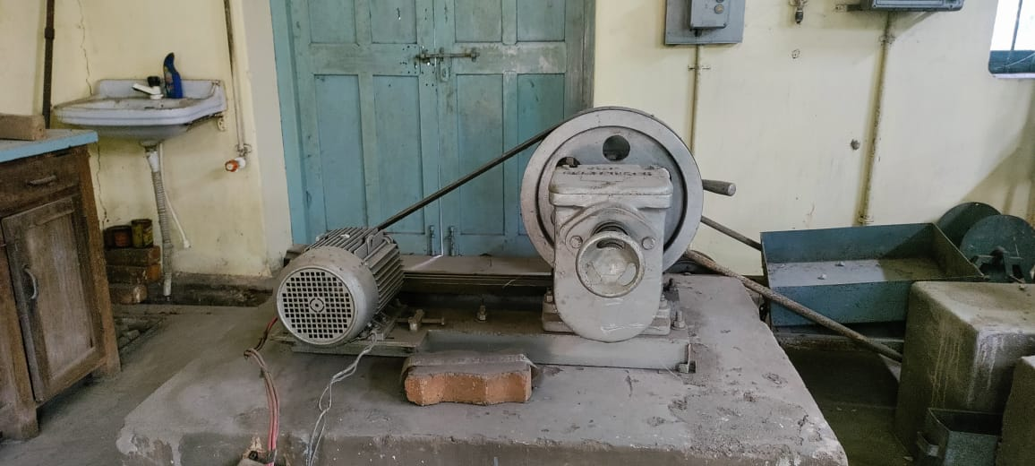
Equipments
AAS
Microscopes
Polishing Machine
Rock cutter
Pulvariser
Grinding Machine

Slide 55
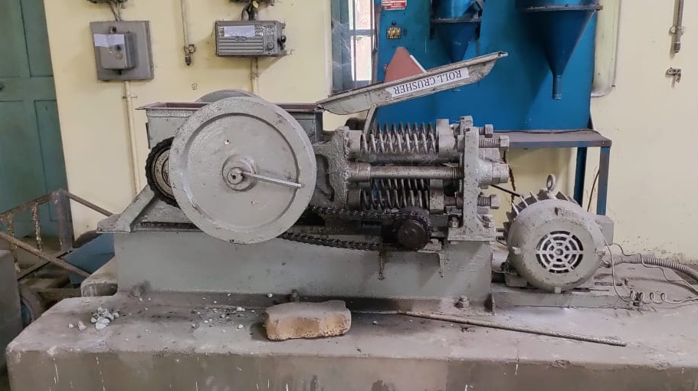
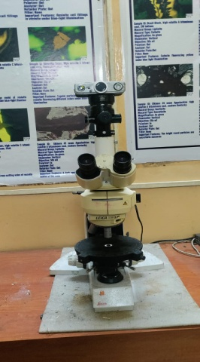
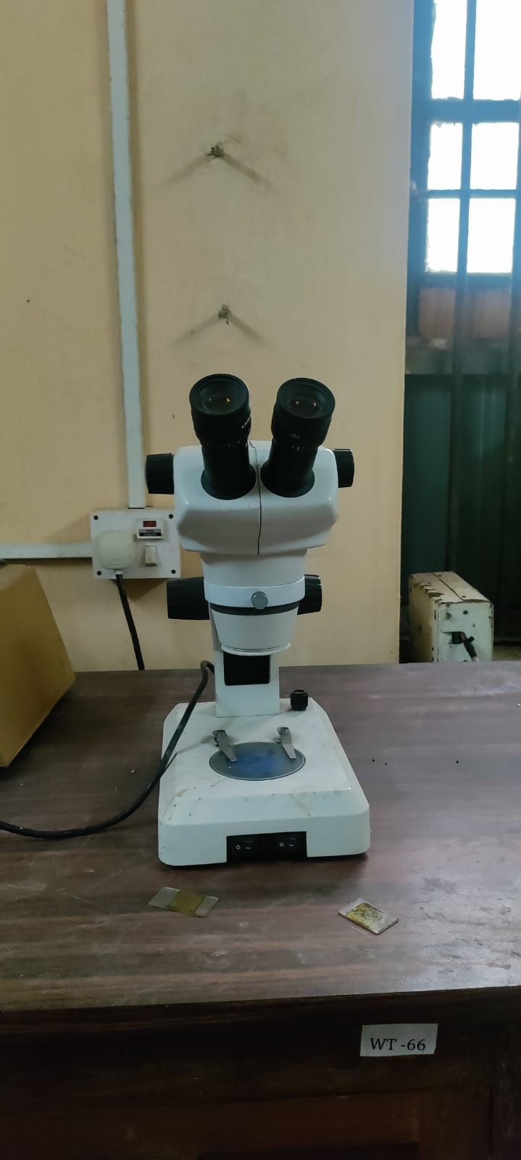
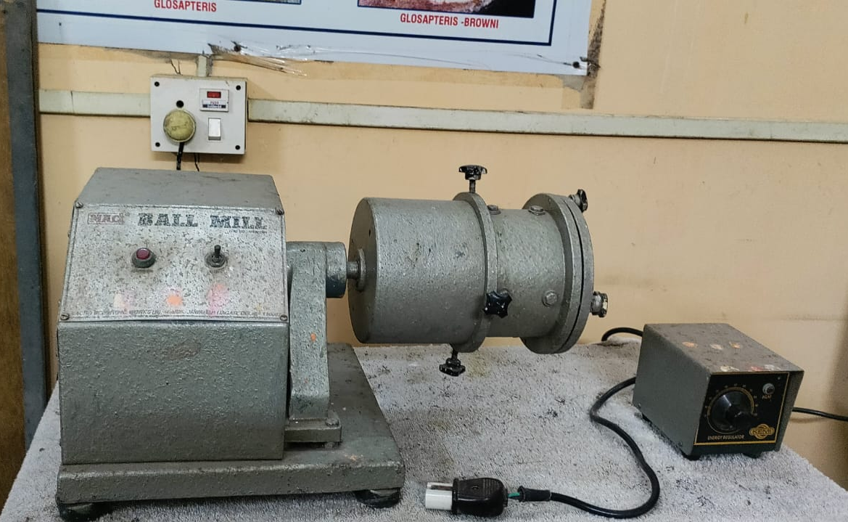
Jaw Crusher
Electromagnetic Separator
Ore Microscopes
Binocular Microscope
Ball mill

Slide 56
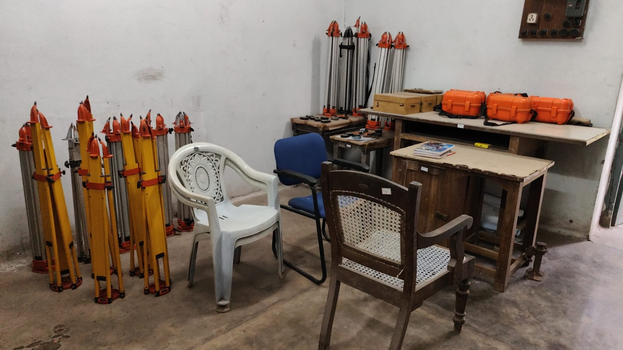
SURVEYING LAB

Slide 57
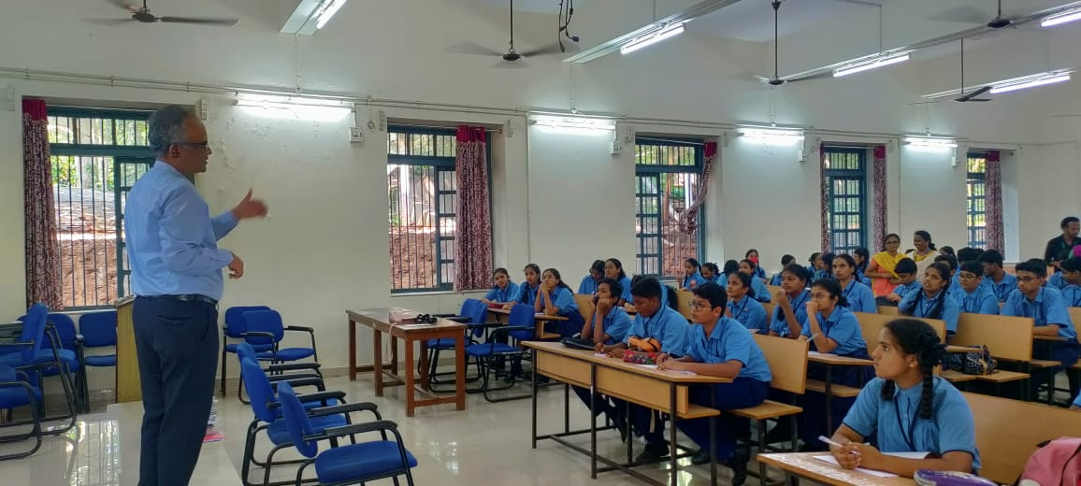
Extension and out reach programmes organized and participated Photographs

Slide 58
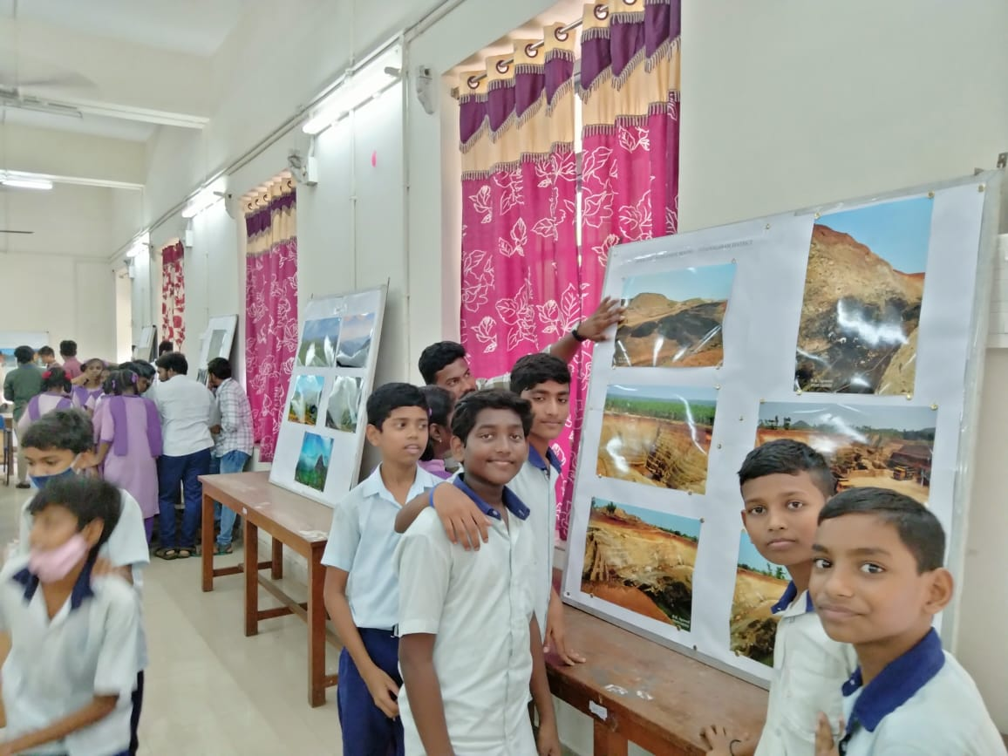
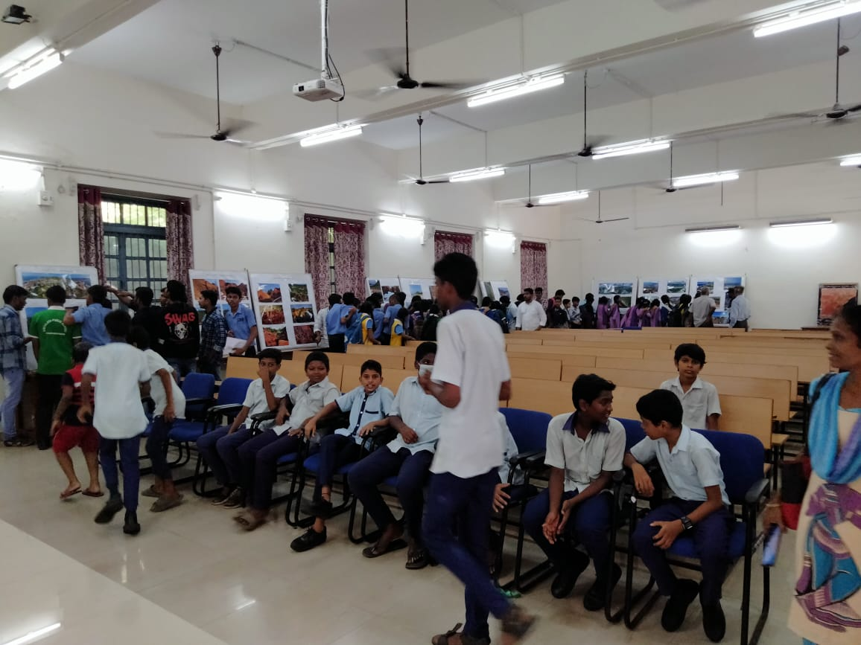
Geological Photo Exhibition

Slide 59
Geological Exhibition organized in collaboration with Indian National Trust for Art and Cultural Heritage (INTACH), Visakhapatnam Chapter

Slide 60
GEO TOURISM SITE
Khondalite “Rock Bridge” near Thotlakonda Beach

Slide 61
GEO TOURISM SITE
Red sediments, INS Kalinga, near Bheemunipatnam

Slide 62
Museum Visit by Mines and Geology Officials, Govt. of AP

Slide 63
Officials of the Mining Engineers Association of India- Visit

Slide 64
Institution values and Social responsibilities:
Energy services
Roof Top Solar Power

Slide 65
Prominent Alumni
Department Alumni served in National and International organizations in various capacities.
IN GOVT. SERVICES
Padmabhusan K. Padmanabhayya, IAS, Former Home Secretary, Govt. of India
Sri. B.K. Rao, Ex Secretary, Ministry of Steel & Mines, Govt. of India
Dr. J. C. Mohanty, I.A.S. Former Secretary, Municipal Administration, Govt. of AP
Sri. C. Karunakaran, Director General, Geological Survey of India
Shri. G. Raju, Director General, Geological Survey of India
Dr. N. Kutumba Rao, Director General, Geological Survey of India
Sri. K. Raghava Rao, W.H.O.
Dr. T. Radha Krishna, FNA, CESS, Thiruvunanthapuram
Dr. V. Poorna Chandra Rao, FNA, NIO, Goa
Dr. B.S. Sarma, Deputy Director General, GSI
Dr. K. Srinivasa Chari, Deputy Director General, Geological Survey of India

Slide 66
IN GOVT. SERVICES
Dr. G.Venkata Ram Reddy, I.A.S.
Sri. G.H.P. Raju, I.P.S.
Sri. A. Ravi Krishna, I.P.S.
Sri. K. Ravi Sankar, Commissioner (GST policy), Commercial Tax
Sri. K. Sambi Reddy, IRS
Sri. W.B. Chandra Sekhar, Joint Director, Mines & Geology, A.P.
Sri. T. S. Raju, CGWB, Faridabad
Sri. K.S. Raju, Chief Controller General, IBM
Sri. N. Subramanyam, Regional Joint Director, A.P. Mines and Geology
Sri. M. Venkateswara Rao, Head, Geological Survey of India Training Institute, Hyderabad.

Slide 67
IN ACADEMICS
Prof. A.S. Naidu University of Alaska, USA
Prof. P.D. Rao University of Alaska, USA
Prof. A. Jagannadha Rao Carnegi Institute, USA
Prof. Bhaskar Rao Adusumilli University of Brazelia
Dr. D.C. Kaminani Geological Society of Canada
Prof. U. Aswadhanarayana Central University
Prof. Leelanandam Osmania University
Dr. S. Balakrishna NGRI
Prof. K.V. Subba Rao Central University
Prof. B. E. Vijayam Osmania University
Prof. R. Jagadeshwara Rao S.V. University
Prof. M. Jagannadha Rao Vice-Chancellor, Adikavi Nannaya University,
Rajamahedravaram
Prof. M. Anji Reddy Vice-Chancellor, Andhra Kesari University, Ongole

Slide 68
IN INDUSTRY
Dr. Ravi Misra, ONGC, OVL
Sri. PVS Prasad, Head, Forward Base, KG Basin, ONGC
Dr. P.V. Satyanarayana, Head, Forward Base, KG Basin, ONGC
Sri. Kamaraju, Head, Forward Base, KG Basin, ONGC
Dr. P.R. Bhavana, Head, Forward Base, KG Basin, ONGC
Sri. DSAN Raju, Head, Forward Base, KG Basin, ONGC
Dr. V.R. Kolla, Chief Advisor, Reliance Petro Chemicals
Dr. Shasavatharam, Director, Alkor Petroo
Dr. Mohinuddin, Consultant to GSPC
Sri. P.S.R. Raju, Industrialist
Dr. P.S.N. Murthy, ESSAR, Gujarat
Mr. K. Appavadhanulu, Chief Consultant in Mining
Mr. M.G. Rao, Consultant to Zindal Alumina Company
Dr. B.V. Ramana Murthy, SECL
Dr. B.B. Sarma, Director, APMDC

Slide 69
Best Practices:
1. Geological Field works
2. Mines Visits
3. Geological Mapping camps.
4. Mining Training Programmes
Future Plans:
1. International Online training on “Geotechnical Applications in Open pit and Underground Mining”
2. As per the recent government of India notification on Critical Minerals [Zr, Ti, and REE] department is emphasing more work along coastal parts in association with APMDC and private Agencies
3. Planning for New MOUs with different scientific organisations like Central Ground Water Department.
4. To get more Research & Consultancy Projects
5. To organise special Trainings for students
6. Every one should be good employee/Employer
7. Emphasis on Societal Impacts : AKRUTHI Project
8. Geoheritage & Geotourism

Slide 70
Thank you

